Slide 1
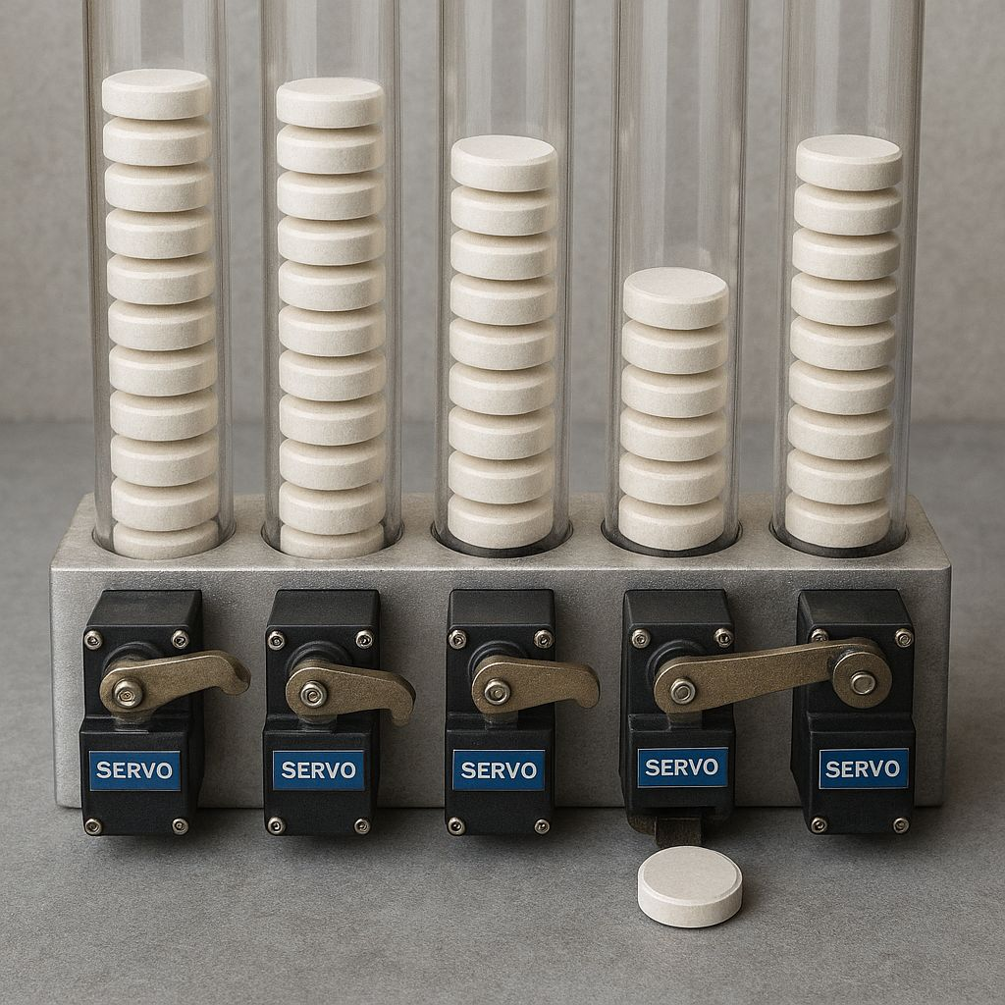
Automatic Medicine Dispenser

Slide 2


Slide 3
Aim/Objective:
1.To automate medicine dispensing using servo motors that release specific medicines from predefined compartments.
2.To allow remote control of the dispenser through a Wi-Fi-based web interface hosted directly on the ESP32.
3. To improve safety and efficiency in medication administration for elderly, disabled individuals, or home-care patients.
4.To reduce human error in taking wrong medicines or missing dosage times.
5.To create a low-cost, portable, smart healthcare device using minimal components and simple implementation.

Slide 4
Component | Cost
Esp32 Board | 600 rupees
Sg90 Servos | 360 rupees
Buzzer | 50 rupees
Data Cable | 110 rupees
Breadboard + Wires | 350 rupees
Miscellaneous Component | 200 rupees

Slide 5
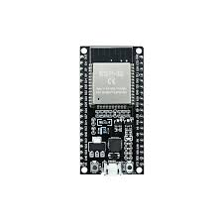
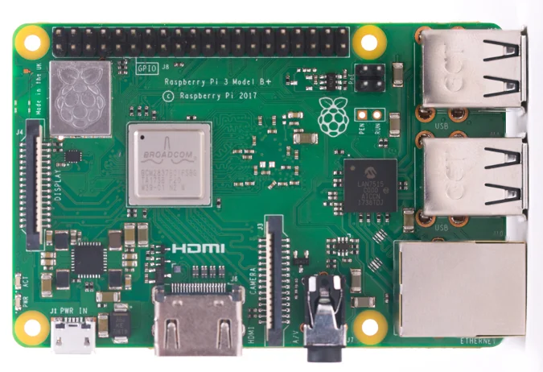
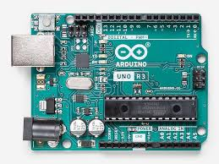
Why ESP32?
ESP32-600 Rupees Raspberry PI-7000 rupees Arduino Uno-1700 rupees
1. Built-in WiFi – No extra module needed to control medicine dispensing wirelessly.
2. Low Cost – Very cheap compared to Raspberry Pi, Arduino + WiFi modules.
3. Fast Processor – 240 MHz CPU makes servo control + webserver smooth.
4. Multiple GPIO Pins – Enough pins to control 3 servos + buzzer easily.
5. Low Power Consumption – Works well in portable setups.

Slide 6
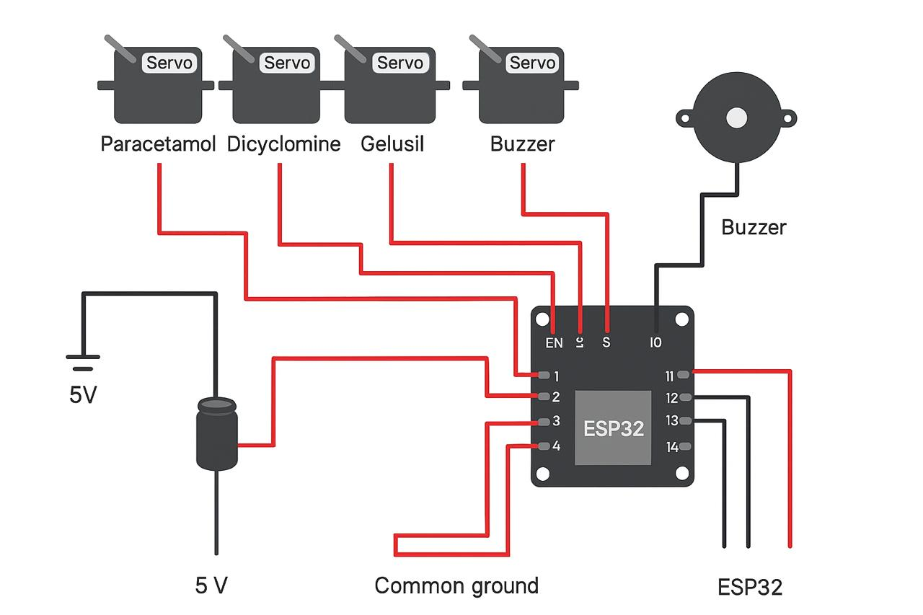
Schematic Diagram:

Slide 7
Working:

Slide 8
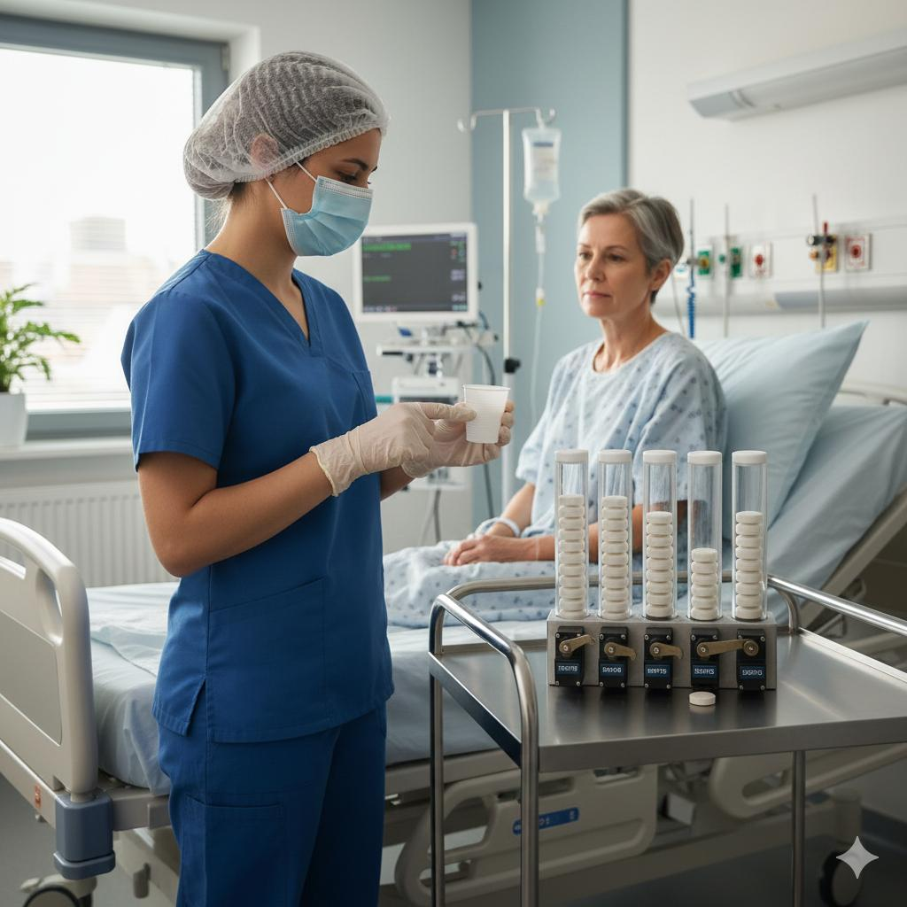
How it is Useful in Hospitals:
1.Reduces Nurse Workload of nurses
2. Minimizes Medication Errors
3. Reduces Physical Contact (Important for ICU / infectious wards)
4. Supports Patients Who Need Frequent Medicines certain patients require medicines every few hours
5. Better Management of Multiple Patients in large hospital
6. Improves Efficiency During Emergencies
7. Useful for Isolation PatientsPatients with infections (TB, COVID, etc.)

Slide 9
Conclusion:
1.The project successfully automates medicine dispensing, reducing human error in dosage and timing.
2.ESP32 proved to be an efficient controller due to its WiFi capability, speed, and low cost.
3.The system improves patient safety by ensuring accurate and timely delivery of medicines.
4.The device can be easily monitored or controlled remotely, making it useful for hospitals and home care.
5.Overall, the project demonstrates a reliable, scalable, and user-friendly solution for modern medical automation.

Slide 10


